Slide 1
Domain-driven design architecture
Pavel Kyurkchiev
PhD. researcher
@pkyurkchiev
https://github.com/pkyurkchiev

Slide 2
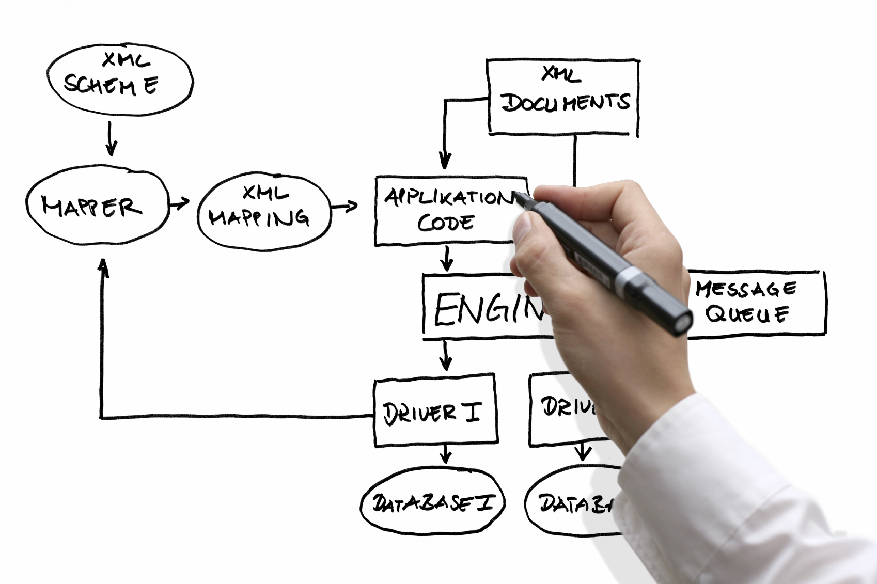

Slide 3
Definition: Domain-driven design (DDD) is an approach to software development for complex needs by connecting the implementation to an evolving model.

Slide 4
Building blocks:
Entity
Value Object
Domain Event
Aggregate
Service
Repositories
Factories

Slide 5
Entity
An object that is identified by its consistent thread of continuity, as opposed to traditional objects, which are defined by their attributes.

Slide 6
Value Object
An immutable (unchangeable) object that has attributes, but no distinct identity.

Slide 7
Domain Event
An object that is used to record a discrete event related to model activity within the system. While all events within the system could be tracked, a domain event is only created for event types which the domain experts care about.

Slide 8
Aggregate
A cluster of entities and value objects with defined boundaries around the group. Rather than allowing every single entity or value object to perform all actions on its own, the collective aggregate of items is assigned a singular aggregate root item. Now, external objects no longer have direct access to every individual entity or value object within the aggregate, but instead only have access to the single aggregate root item, and use that to pass along instructions to the group as a whole.

Slide 9
Service
Essentially, a service is an operation or form of business logic that doesn’t naturally fit within the realm of objects. In other words, if some functionality must exist, but it cannot be related to an entity or value object, it’s probably a service.

Slide 10
Repositories
Not be confused with common version control repositories, the DDD meaning of a repository is a service that uses a global interface to provide access to all entities and value objects that are within a particular aggregate collection. Methods should be defined to allow for creation, modification, and deletion of objects within the aggregate. However, by using this repository service to make data queries, the goal is to remove such data query capabilities from within the business logic of object models.

Slide 11
Factories
As we’ve discussed through a number of design patterns articles already, DDD suggests the use of a factory, which encapsulates the logic of creating complex objects and aggregates, ensuring that the client has no knowledge of the inner-workings of object manipulation.

Slide 12
Advantages of DDD:
Eases Communication
Improves Flexibility
Emphasizes Domain Over Interface

Slide 13
Eases Communication
With an early emphasis on establishing a common and ubiquitous language related to the domain model of the project, teams will often find communication throughout the entire development life cycle to be much easier. Typically, DDD will require less technical jargon when discussing aspects of the application, since the ubiquitous language established early on will likely define simpler terms to refer to those more technical aspects.

Slide 14
Improves Flexibility
Since DDD is so heavily based around the concepts of object-oriented analysis and design, nearly everything within the domain model will be based on an object and will, therefore, be quite modular and encapsulated. This allows for various components, or even the entire system as a whole, to be altered and improved on a regular, continuous basis.

Slide 15
Emphasizes Domain Over Interface
Since DDD is the practice of building around the concepts of domain and what the domain experts within the project advise, DDD will often produce applications that are accurately suited for and representative of the domain at hand, as opposed to those applications which emphasize the UI/UX first and foremost. While an obvious balance is required, the focus on domain means that a DDD approach can produce a product that resonates well with the audience associated with that domain.

Slide 16
Disadvantages of DDD:
Requires Robust Domain Expertise
Encourages Iterative Practices
Ill-Suited for Highly Technical Projects

Slide 17
Requires Robust Domain Expertise
Even with the most technically proficient minds working on development, it’s all for naught if there isn’t at least one domain expert on the team that knows the exact ins and outs of the subject area on which the application is intended to apply. In some cases, domain-driven design may require the integration of one or more outside team members who can act as domain experts throughout the development life cycle.

Slide 18
Encourages Iterative Practices
While many would consider this an advantage, it cannot be denied that DDD practices strongly rely on constant iteration and continuous integration in order to build a malleable project that can adjust itself when necessary. Some organizations may have trouble with these practices, particularly if their past experience is largely tied to less-flexible development models, such as the waterfall model or the like.

Slide 19
Ill-Suited for Highly Technical Projects
While DDD is great for applications where there is a great deal of domain complexity (where business logic is rather complex and convoluted), DDD is not very well-suited for applications that have marginal domain complexity, but conversely have a great deal of technical complexity. Since DDD so heavily emphasizes the need for (and importance of) domain experts to generate the proper ubiquitous language and then domain model on which the project is based, a project that is incredibly technically complex may be challenging for domain experts to grasp, causing problems down the line, perhaps when technical requirements or limitations were not fully understood by all members of the team.

Slide 21
ORM (Object-Relational Mapping)

Slide 22
Business layer structure
Business logic
Business rules
Business logic comprises

Slide 23
import {Component} from '@angular/core'; import {Vehicle} from './vehicle.service'; @Component({ moduleId: module.id, selector: 'story-vehicles', templateUrl: 'vehicles.component.html' }) export class VehicleListComponent { vehicles: Vehicle[]; }
Anatomy of Component

Slide 24
demo Components

